Slide 1
EDA on Play Store App Review
By Vishnu B
GitHub Link - https://github.com/bvishnub/Exploratory-Data-Analysis-on-Play-Store-App-Review
Email Id – vishnub195@gmail.com

Slide 2
Index
Introduction
Dataset Features
Dataset Cleaning
Data Exploration
Top App Categories
Free Vs Paid
Genre
Content Rating
Size of App
Android Version
Paid Apps Findings
Based On Sentiment
Based on Ratings and Reviews
App Based Findings
Recommendations
Conclusion

Slide 3
Introduction
The Android app market is growing rapidly and becoming more competitive, with developers constantly releasing new apps. To succeed, developers need to target specific user segments based on their behavior. User ratings, which reflect satisfaction, are a key performance indicator for making decisions. The project aims to analyze the Play Store app and user review data to come up with actionable insights which can help developers work on and capture the Android market leading to app-making business success.
Two Data Set are provided by AlmaBetter team for analysis –
Play Store Data
User Review Data
Data Set Shape
Play Store Data has (10841 Rows and 13 Columns)
User Review Data has (64295 Rows and 5 Columns)

Slide 4
Dataset Features
Play Store App Dataset Variables
App - Name of the application.
Category -App category and same is categorical in nature.
Reviews - The count of reviews for the app and categorical in nature and 55% unique value, needs to be converted to numerical.
Size - stands for the size of the application in MB and KB, which needs to be converted to numerical.
Installs - total number of downloads of the respective app, need to be converted to numerical.
Type- Free or Paid distinguish among apps.
Price - Installation charges, needs to be converted to numerical.
Content - which age group can download the app - categorical in nature.
Genre - Genre of the app.
Last Updated - The date when the app was last updated needs to be converted to datetime.
Current Ver - current version of the app.
Android Ver - Android version required to download the app.
User Review Dataset Variables
App -Name of the application.
Translated_Review - Translation of the review given by the customer about the application
Sentiment - Sentiment of the consumer +ve , -ve or neutral.
Sentiment_Polarity -Polarity of the review and range is [-1,1].
Sentiment_Subjectivity - Range is [0,1].Helps in understanding whether the feedback is based on personal preferences or factual issues.

Slide 5
DataSet Cleaning
Below are the manipulations done to clean both the dataframes –
Playstore Data Frame-
Dropped 1 row (outlier) having rating above 5 ,as rating should be in the 0-5 as per data.
Filled the null values in rating column with median as there are outier present in the column and data is skewed towars left.
Dropped rows from("Type","Content Rating",'Current Ver',"Android Ver") containing null values as null values were very less even less than 0.1%.
Reviews data set converted to integer and Last Updated data converted to date time for further analysis.
Converted the size column which is mix of KB and MB to MB and and imputed the "Varies with device" (size) option with median .
Converted Installs column to numeric.
Converted price column to numeric (float).
Checked outliers using 6 sigma method , but not droped the same , as we have not enough information about the outliers.
User Review DataFrame-
Dropped rows where Transelated reviews values were null since sentiment Sentiment_Polarity Sentiment_Subjectivity are based on that.
Merged DataFrame - Created a new data frame merging both the data frames and no null values found in the same.

Slide 6
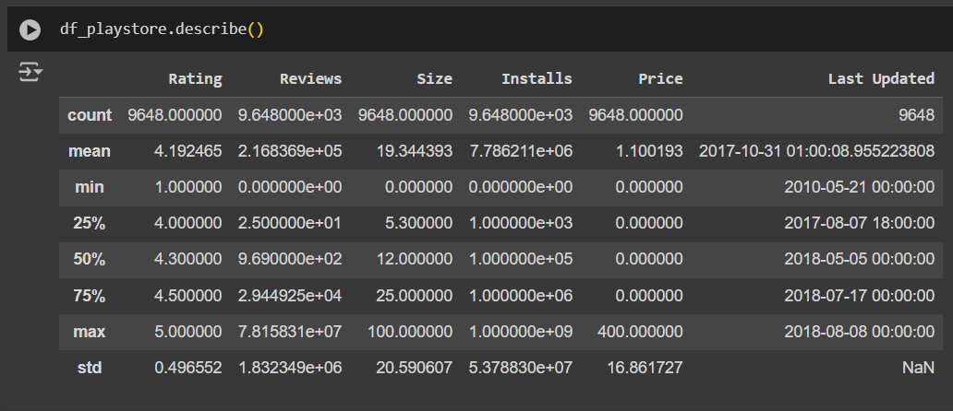
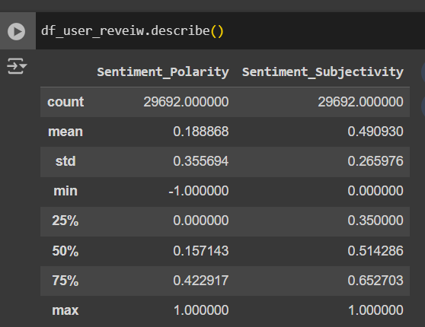
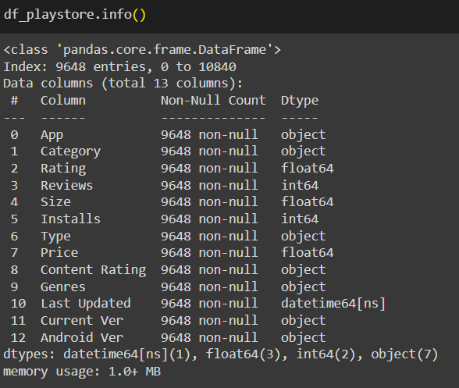
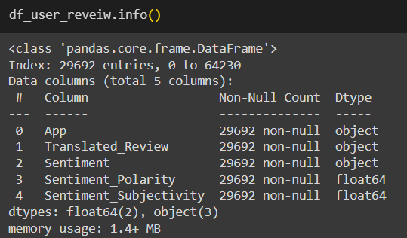
Data Exploration
Playstore data description after cleaning User Review data description after cleaning.

Slide 7
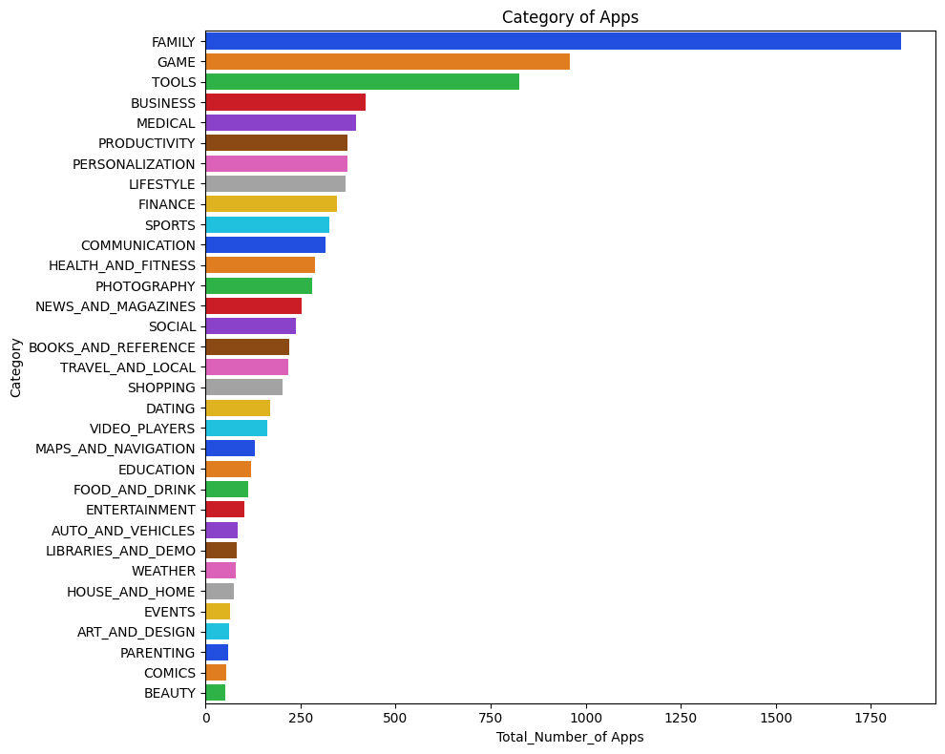
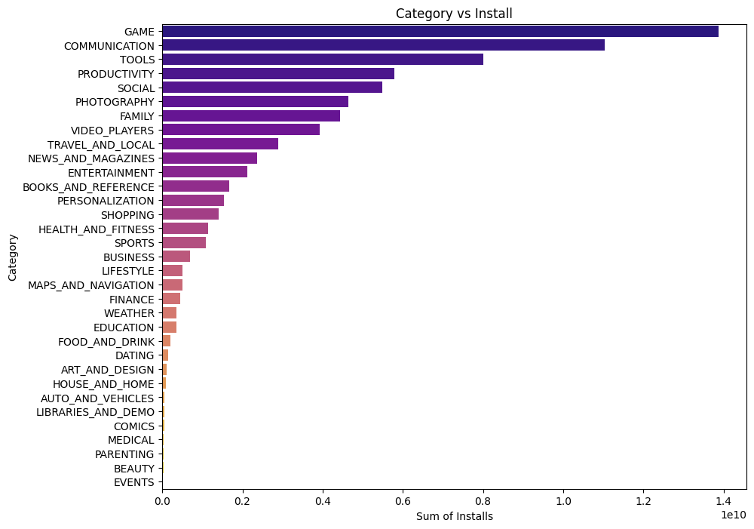
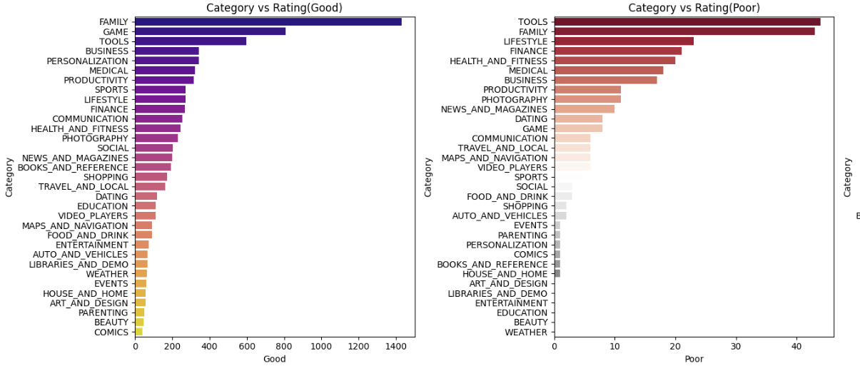
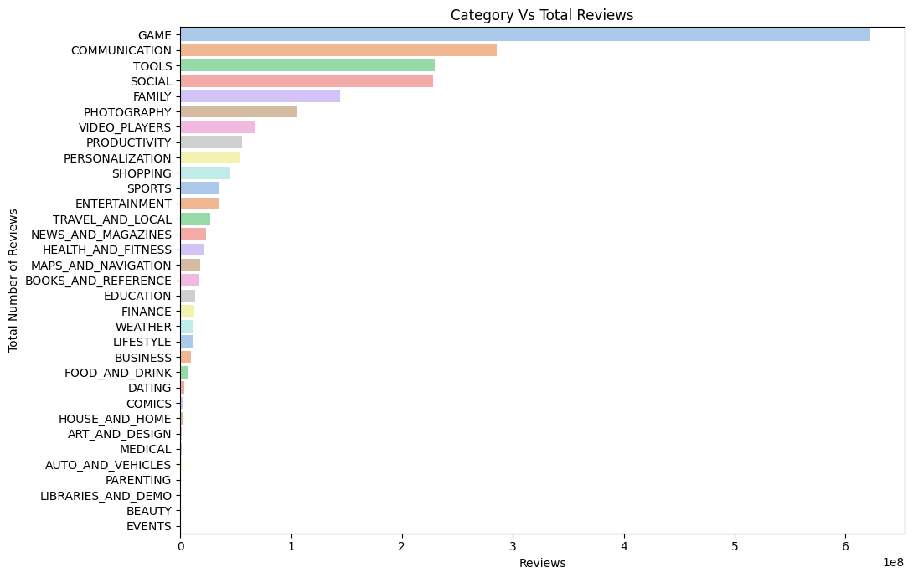
Top App Categories
Family, Games, Tools, Business, and Communication categories are mostly downloaded, also having good ratings above 4 and a good count of reviews.

Slide 8
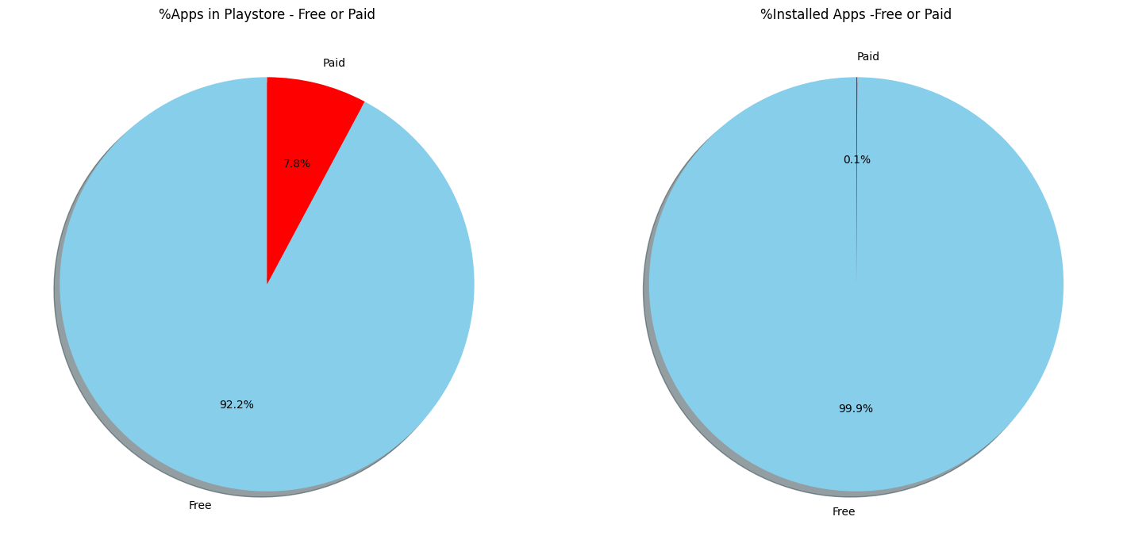
Free Vs Paid
Free applications are downloaded majorly by consumers with a whole percentage of 99.9%.

Slide 9
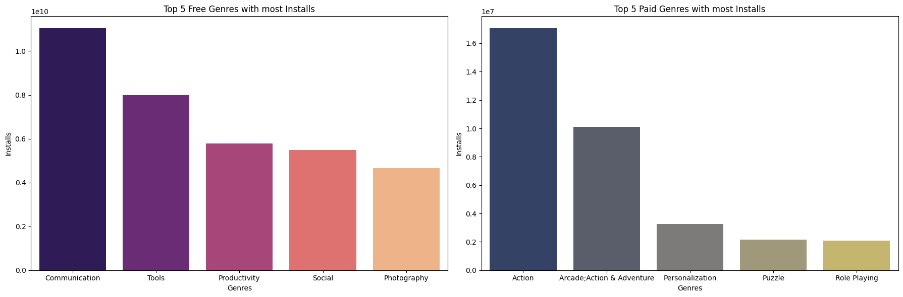
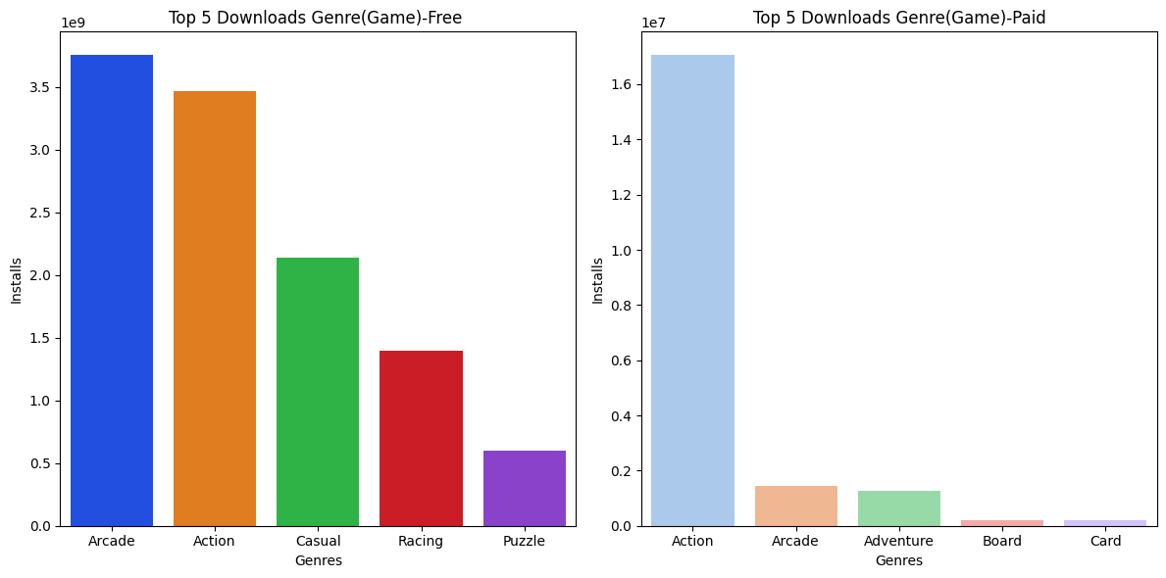
Genre
Communication, Tools, Productivity, Social, and Photography are the most preferred and downloaded at the consumer end. Under Games Category - most downloaded apps are under Genre -arcade, action, casual, Racing, puzzle.

Slide 10
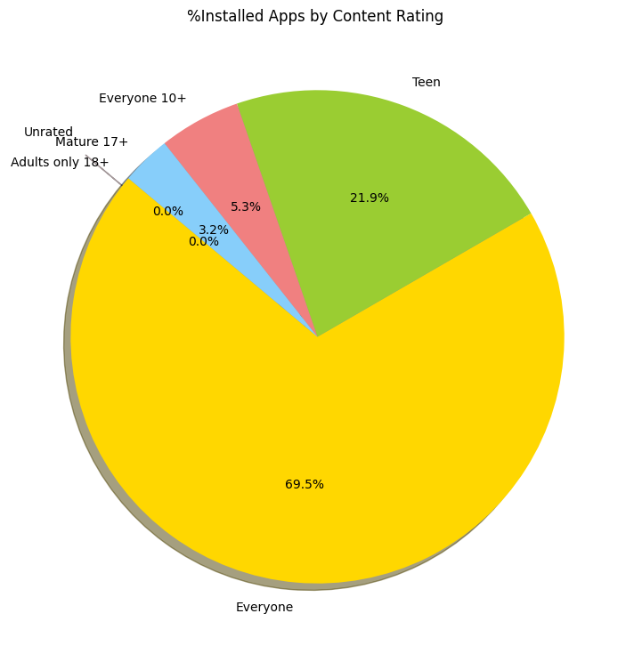
Content Rating
Everyone age group has the most number of installs with 69.5%.

Slide 11
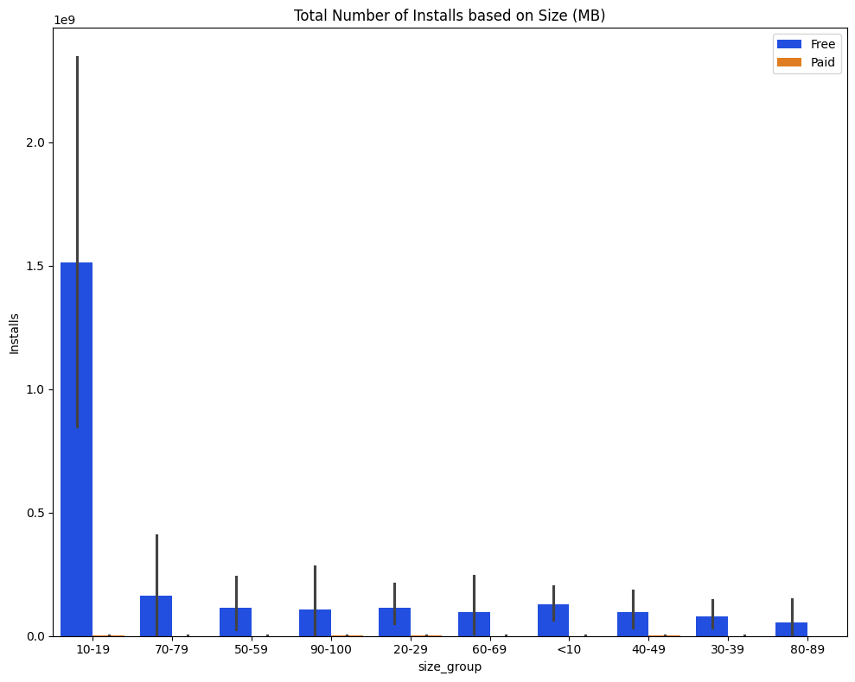
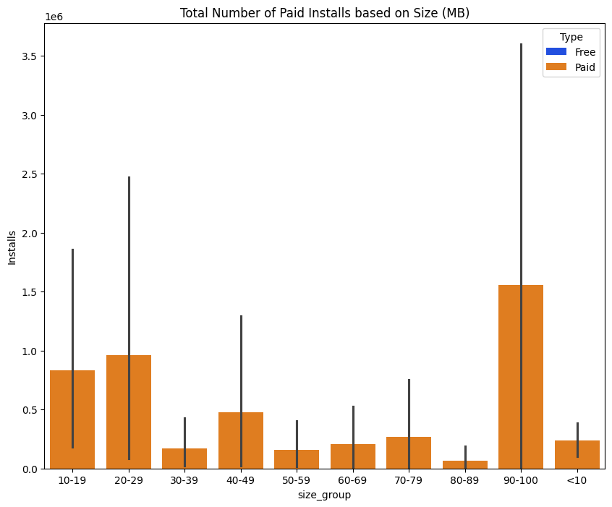
Size of App
Consumers tend to download small apps, and here size group 10-19 MB was majorly installed. For paid section installs were also for 90-100mb and 20-29 mb.

Slide 12
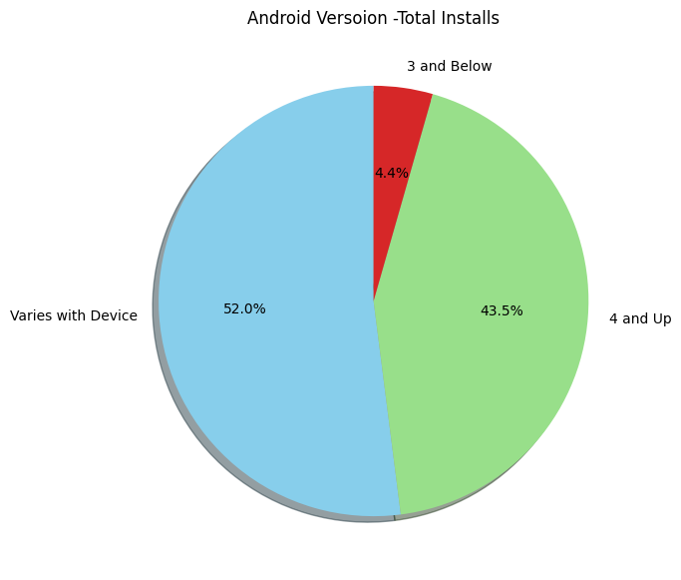
Android Version
52% of downloads were for Android Version - Varies with Device and 43.5% downloads for Android version 4 and above.

Slide 13
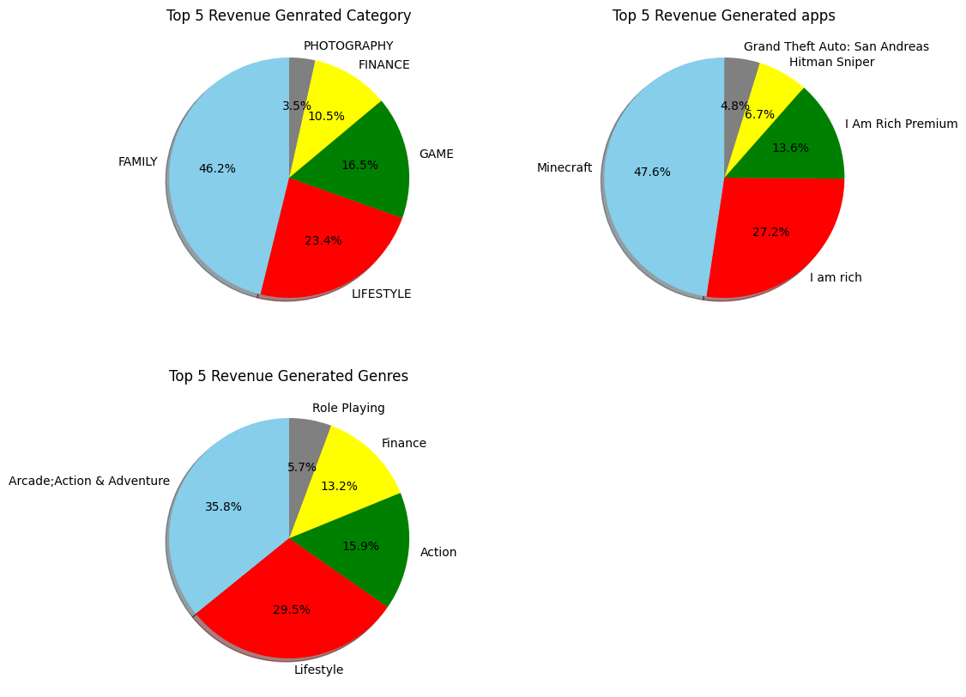
Paid Apps Findings
Most revenue generated Category is Family (46.2%), Lifestyle (23.4%) and game (16.55%) all over, Most revenue-generated Genres are Arcade Action and Adventure (35.8%), Lifestyle(29.5%) and Action 15.9%., Minecraft is the most revenue (47.6%) generated app in the Play Store.

Slide 14
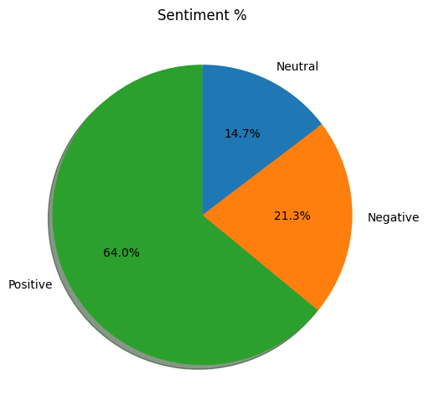
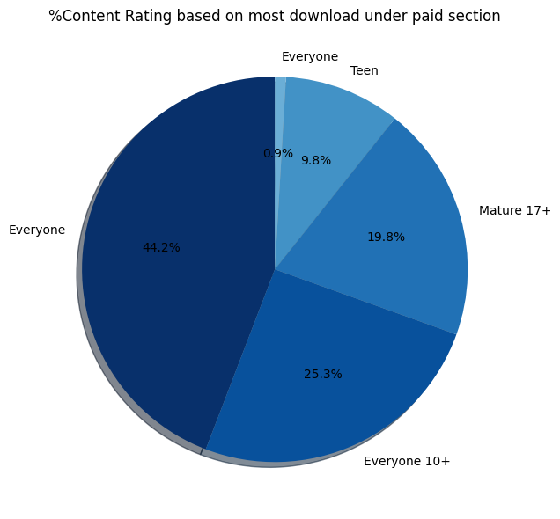
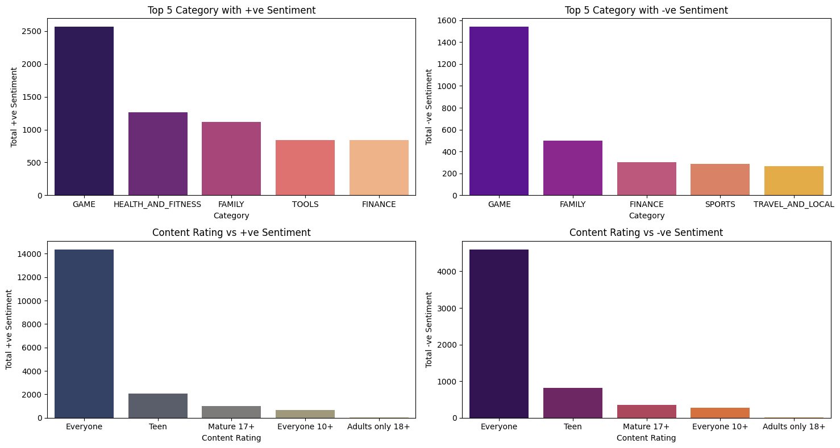
Based On Sentiment
Overall Sentiment is 64% Positive, 21.3% Negative, 14.7% Neutral.
Game, Health and Fitness, Family, Tools, and Finance are the top 5 categories with maximum +ve sentiment received from consumer end with age group that of Everyone.

Slide 15
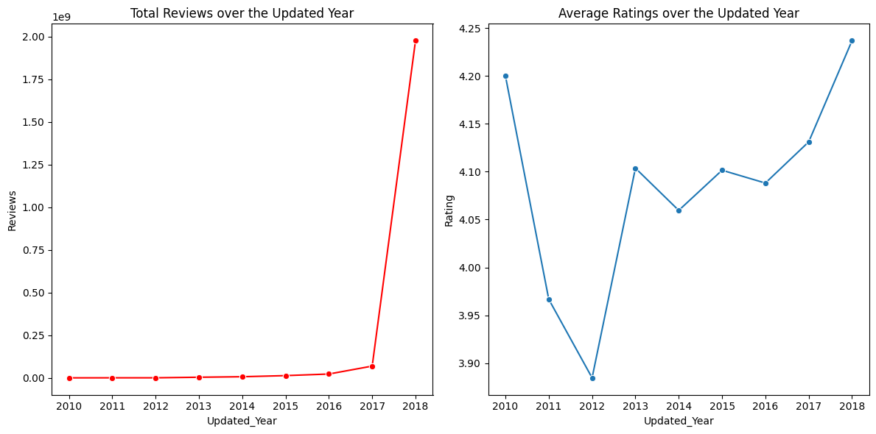
Based on Ratings and Reviews
Timely Updates need to be rolled out to improve the performance and quality of the app and to keep the consumer engaged, considering the reviews leading to improvement in Average rating.

Slide 16
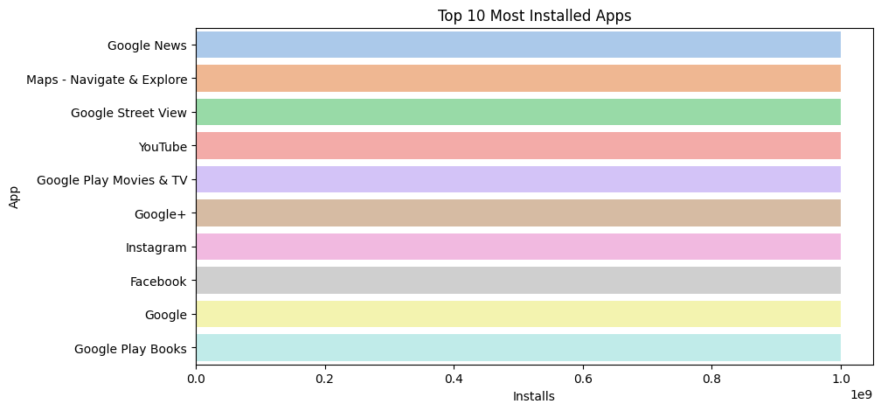
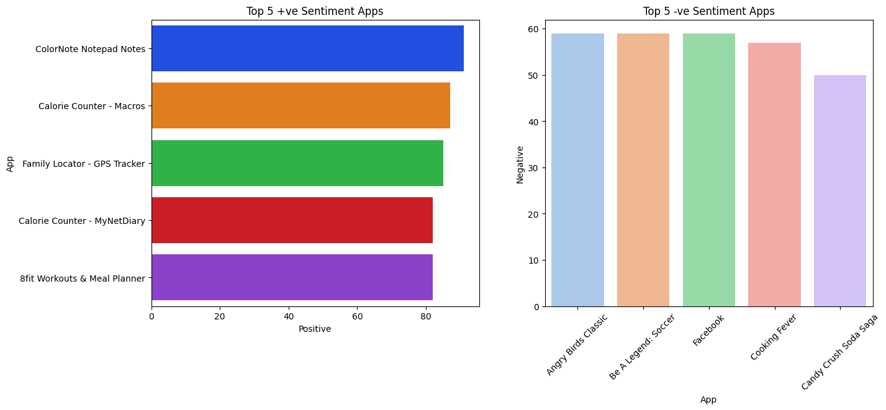
App Based Findings
Google News, Maps - Navigate & Explore, Google Street View, YouTube, Google Play Movies & TV, Google+, Instagram, Facebook, Google, and Google Play Books are the top 10 most installed apps in the Play Store.
ColorNote Notepad Notes, Calorie Counter-Macros, Family Locator - GPS Tracker, Calorie Counter - MyNetDiary, 8fit Workouts & Meal Planner are the top 5 most +ve sentiment apps.

Slide 17
Recommendations
Category - Family, Games, Tools, Business, Communication
Type - Free
Genre - Communication , Tools, Productivity , Social ,Photography
Content Rating - Everyone
Size - 10-19 MB
Android Version - Varies with Device or 4 & Above
Paid Apps - Grouping the paid section , found that most downloads are for apps pricing below 10$ in comparison with other price categories , however maximum price observed was till 400 Dollar and age group with maximum download under paid section is that of Everyone. Most revenue generated Category is Family (46.2%) , Lifestyle (23.4%) and game (16.55).
Based on Sentiment-Game, Health and Fitness , Family , Tools, Finance are the top 5 categories with maximum +ve sentiment received from consumer end with age group that of Everyone.
Based on Ratings and Reviews-Timely Updates needs to be rolled out to improve the performance and quality of the app and to keep the consumer engaged, considering the reviews leading to improvement in Average rating.

Slide 18
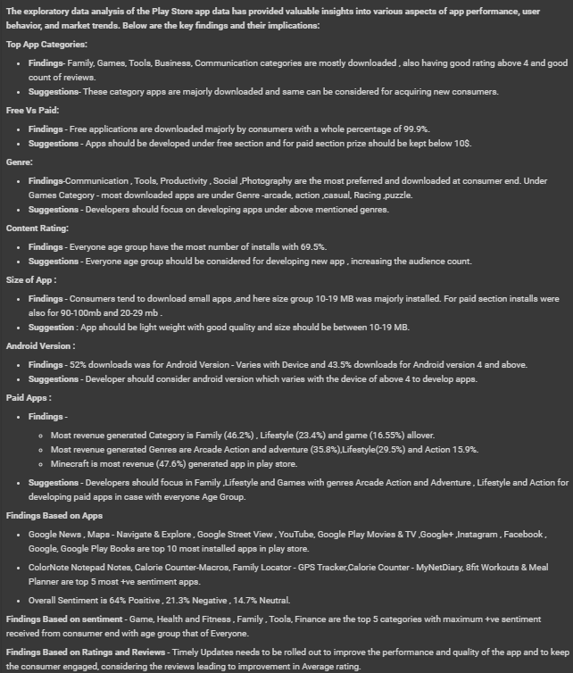
Conclusion

Slide 19
Thank you ☺

